Slide 1
CASE STUDY · RETAIL SALES ANALYTICS
From Raw Rows to
Retail Insight
A Superstore Sales Analysis — presented as a freelance client project
Freelance Data Analytics Team · Graduation Project 2026
Notes:
Open confidently with the project title and framing - this is a real client-style presentation.

Slide 2

WHO WE ARE
Our Team
Youssef Mohamed Fatohy
David Usama Maher
Rana Essam Reda
Gehan Hazem Kamal
02
Notes:
Quick round: each teammate says their name only, keep it moving fast.

Slide 3




THE BRIEF
Project Overview
Our client — a mid-size US retail chain — had years of sales data locked away in spreadsheets, but
no clear view of what sells, where, and when demand shifts.
As their freelance analytics team, we were brought in to turn raw transactional records into a decision-ready story: clean the data, uncover the patterns, and deliver an interactive dashboard leadership could actually act on.
Clean
Fix, standardize & validate the raw dataset
Query
SQL analysis for trends & KPIs
Visualize
Interactive Power BI dashboard
03
Notes:
Explain the fictional client brief in plain language. Set up the 3-step process shown on screen: Clean, Query, Visualize.

Slide 4
THE DATASET
Data Description
A four-year US retail transaction log — rich enough to tell a real story, and messy enough to need real cleaning.
9,800
18
2015–19
3
Orders
Data Columns
Years Covered
Product Categories
Key fields we worked with:
Order & Ship Dates
Ship Mode
Customer & Segment
Region, State, City
Category & Sub-Category
Product Name
Sales Value
04
Notes:
Walk through dataset scale (9,800 orders, 18 columns, 2015-2019, 3 categories). Mention the field list briefly.

Slide 5


BEHIND THE SCENES
Data Preparation — Our Approach
Two-stage cleanup: Python for structure, SQL for validation — zero missing values by the end.
Python & pandas
SQL Validation
Detected 11 missing postal codes with df.isna().sum()
Checked for duplicate rows with df.duplicated()
Converted Order/Ship Date columns to true datetime objects
Standardized postal codes & trimmed whitespace text columns
Normalized column names to lowercase/underscore
Queried for NULL Customer_ID / postal_code across the table
Updated missing postal codes to a verified default value
Removed duplicates via self-join & ROW_NUMBER window function
Checked Sales for zero/negative values (data-integrity check)
Confirmed a clean, query-ready table for analysis
05
Notes:
Give the 30-second summary of both cleaning stages before diving into the two detailed workflow slides that follow.

Slide 6
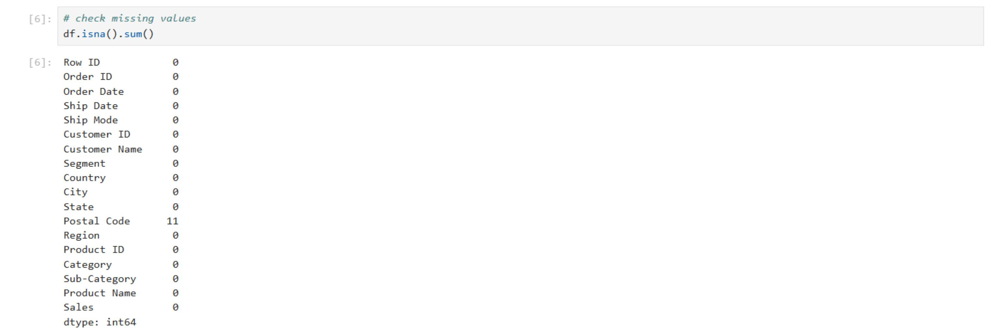

STAGE 1 · NOTEBOOK WALKTHROUGH
Python Cleaning Workflow
What we ran
df.isna().sum() to scan every column for missing values
df.duplicated() to flag repeated order rows
df.fillna(0) applied selectively after confirming safe defaults
Finding
Exactly 11 records were missing a Postal Code — every other one of the 18 columns came back clean. We traced those 11 rows to Burlington, VT orders and filled them with the correct verified postal code instead of dropping real sales data.
Actual notebook cell: df.isna().sum()
06
Notes:
This is a real notebook screenshot - point at the missing value count (11) and explain how you traced and fixed it.

Slide 7
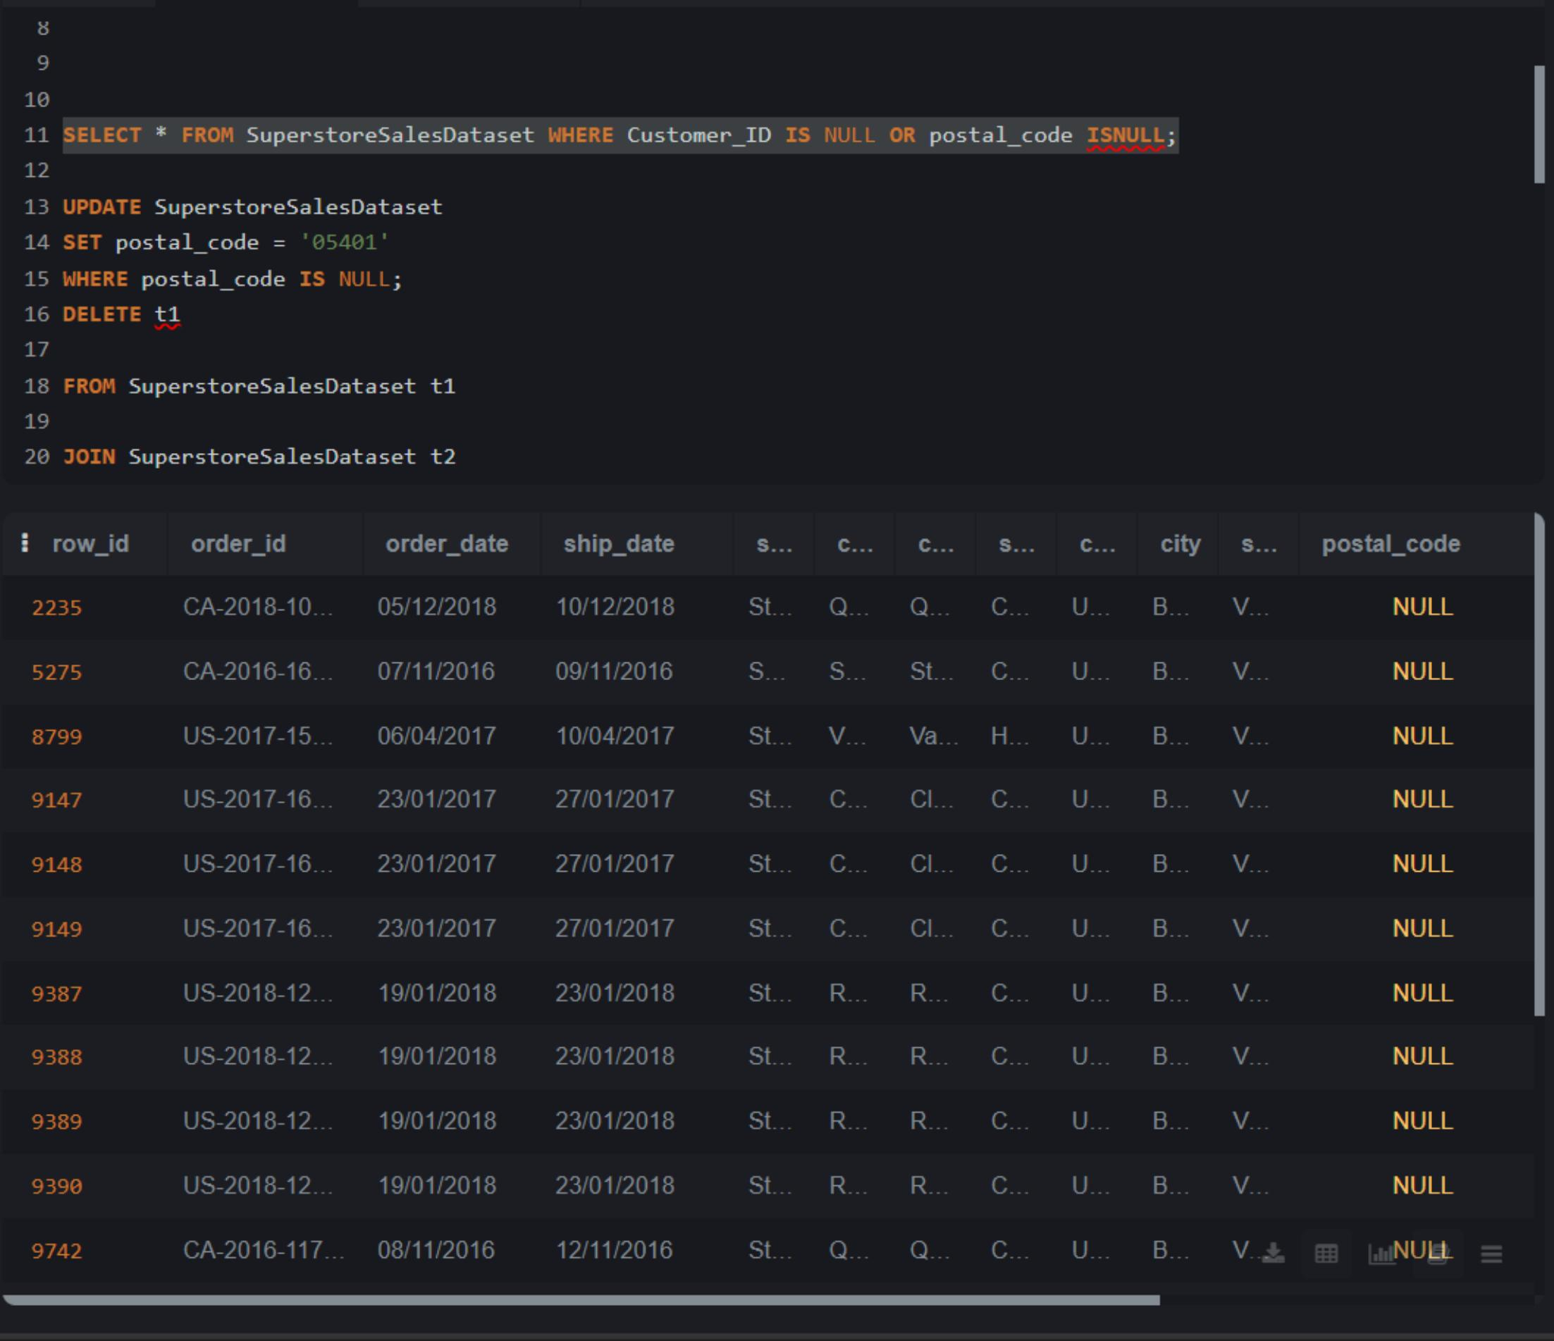
STAGE 2 · QUERY VALIDATION
SQL Workflow & Queries
Queries we wrote
SELECT ... WHERE Customer_ID IS NULL OR postal_code ISNULL
UPDATE ... SET postal_code = '05401' WHERE postal_code IS NULL
DELETE duplicate rows via self-join on Order_ID + Product_ID
SELECT * WHERE Sales <= 0 — data integrity check
Findings
SQL cross-confirmed the same 11 null postal codes found in Python. The Sales <= 0 check returned zero rows — no negative or free-value transactions in the entire dataset, meaning revenue figures could be trusted as-is.
Actual query: locating & fixing NULL postal codes
07
Notes:
This is a real SQL screenshot - walk through each query left to right, then land on the two findings: matching null count and zero invalid sales rows.

Slide 8




WHAT THE DATA TOLD US
Key Insights
Revenue is concentrated
Technology leads
Shipping is lopsided
$1.91M in revenue from ~4K orders & 791 customers — West + East regions drive over 60% of sales.
The top-performing category overall, with Chairs, Phones & Binders as standout sub-categories.
Standard Class dominates order volume; Same Day shipping is barely used — an untapped lever.
Sales are seasonal
Consumers drive growth
Dips every Feb & June; sharp peaks in March, September, and the Nov–Dec holiday rush.
The Consumer segment alone accounts for just over 50% of total sales.
08
Notes:
The insight slide is the heart of the talk - slow down here. One sentence per card.

Slide 9
BY THE NUMBERS
Regional & Segment Breakdown
Sales Share by Region
Sales Share by Segment
West
31.5% · $600.5K
50.5%
30.6%
18.9%
East
29.5% · $562.2K
$963.6K
$583.6K
$359.7K
Central
21.6% · $410.9K
Consumer
Corporate
Home Office
South
17.5% · $333.1K
Standard Class ships 3× more orders than every other ship mode combined — while Same Day remains under 8% of volume.
09
Notes:
Use this as a supporting data slide - let the bars speak while you emphasize the closing line about Standard Class vs Same Day shipping.

Slide 10
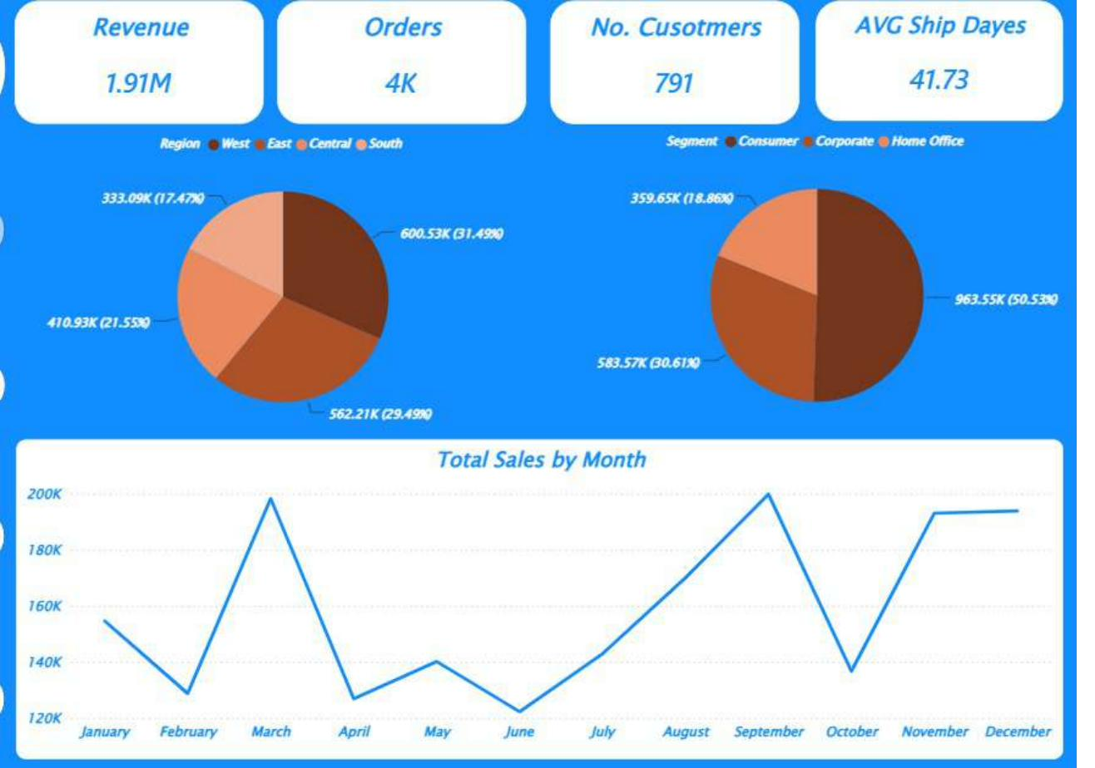
THE DELIVERABLE
Data Visualization — Power BI Dashboard
A 5-page interactive dashboard turning every insight above into something the client can explore themselves.
Executive Overview
Revenue, orders, customers & average ship days at a glance
Regional & segment share, side by side
Monthly sales trend across all 4 years
10
Notes:
Introduce the Power BI dashboard as the deliverable. Point at each bullet on the right while gesturing to the image.

Slide 11
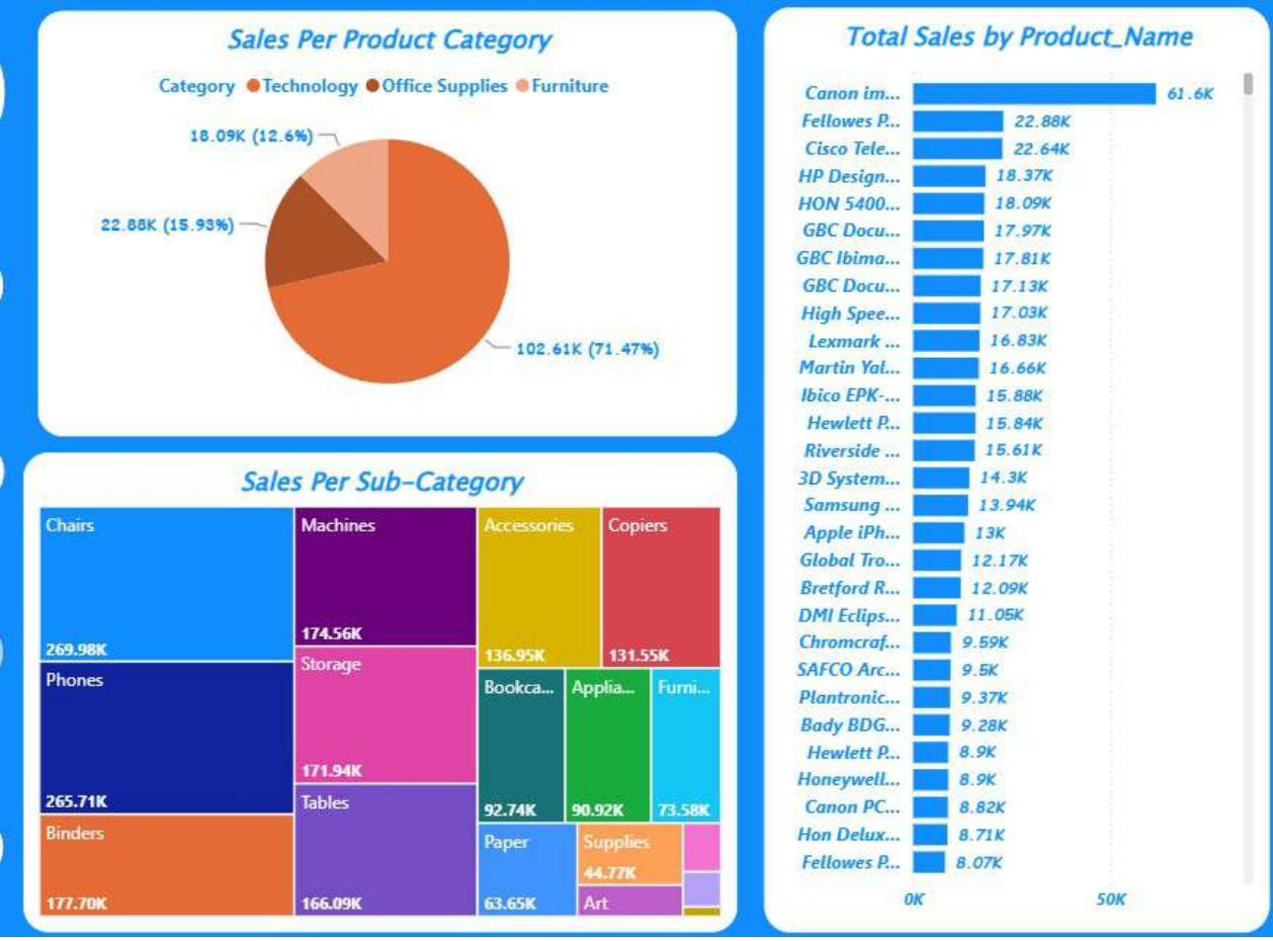
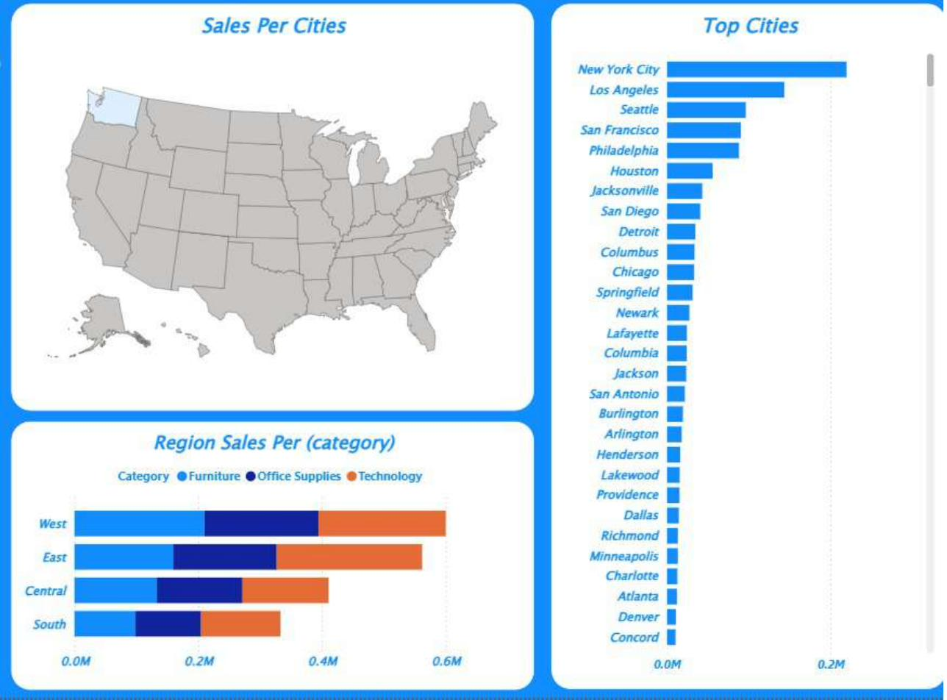
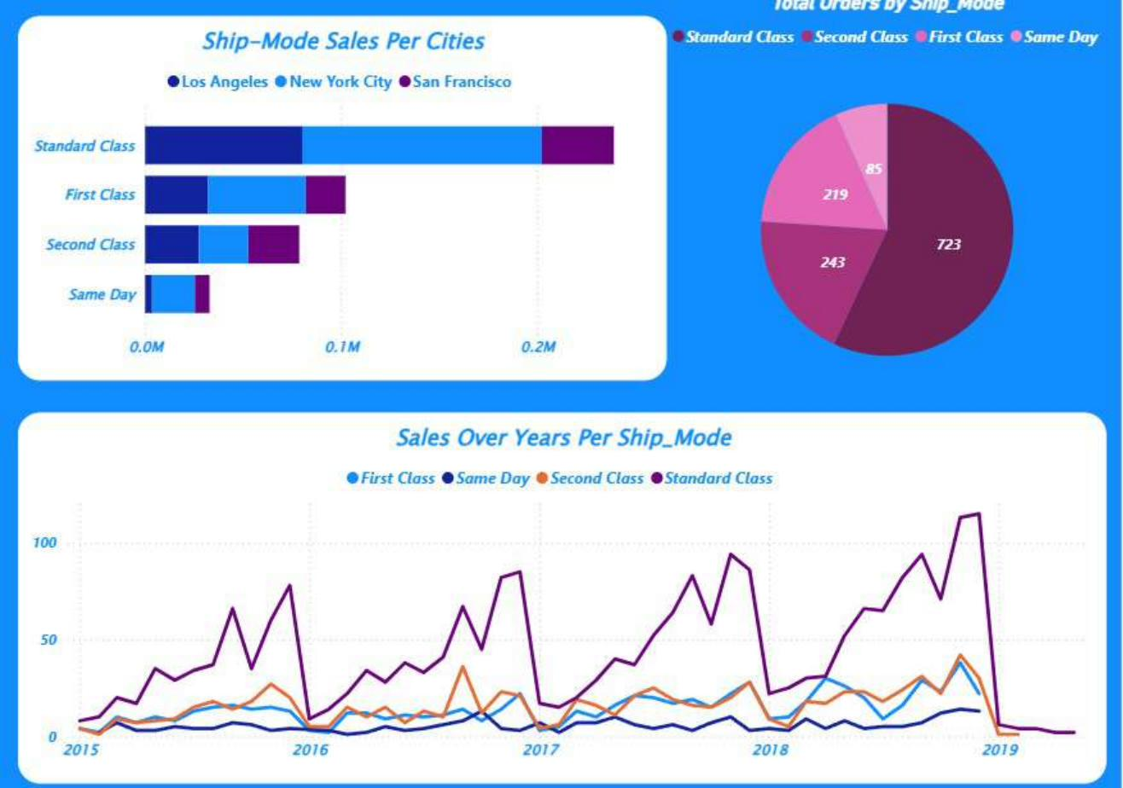
THE DELIVERABLE
More Views From the Dashboard
Category & Sub-Category Breakdown
Geographic Sales & Top Cities
Shipping Mode Trends Over Time
11
Notes:
Move faster here - 10-15 seconds per panel. Name what's on each panel without re-explaining insights already covered.

Slide 12

Thank You
From a messy spreadsheet to a dashboard our client runs their business on.
Questions welcome
Notes:
Thank the audience, invite questions, end on time.

